Slide 1
EE 261
ASYNCHRONOUS & DC MACHINES
Presented by: Dr. Philip Yaw Okyere

Slide 2
Armature Windings
Armature windings are the windings of a rotating machine in which motional emfs are induced.
These emfs give rise to mechanical/electrical energy conversion.
The armature windings consist of coils connected in series or series-parallel circuits.
The coils are properly placed so that their individual emfs can be effectively collected
In this chapter we look at how conductors are placed in rotating machines,
how they are interconnected to obtain coils and
how the coils are interconnected to give armature windings for effective collection of the emfs induced in the conductors.
The expression for the total emf induced in the armature winding is also derived.

Slide 3
Armature-conductor connection
Two conductors and connected back to back form a single-turn coil.
The two sides of the coils are spaced in such a way that when one of its sides is under the influence of a north pole say, its other side is under the influence of a south pole for most of this time.
Multi-turn coils consist of 4 or more conductors.

Slide 4
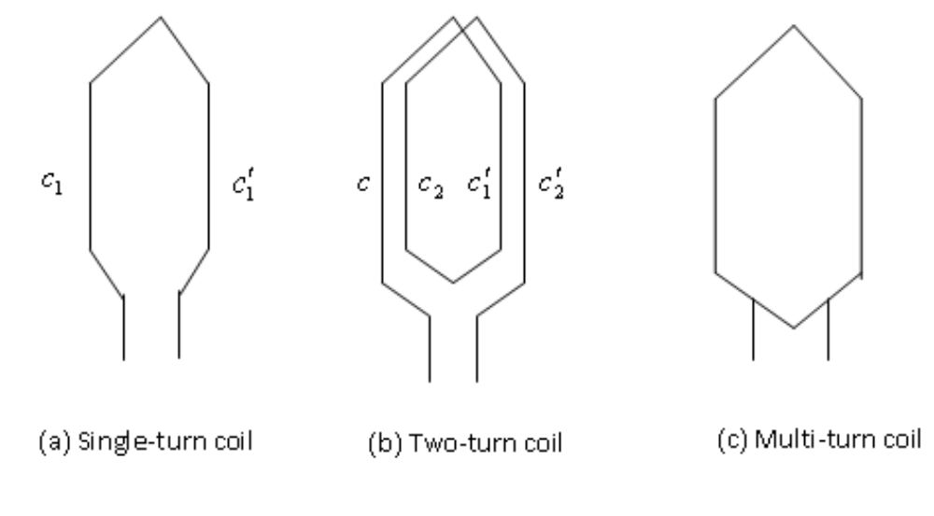
Armature-conductor connection

Slide 5
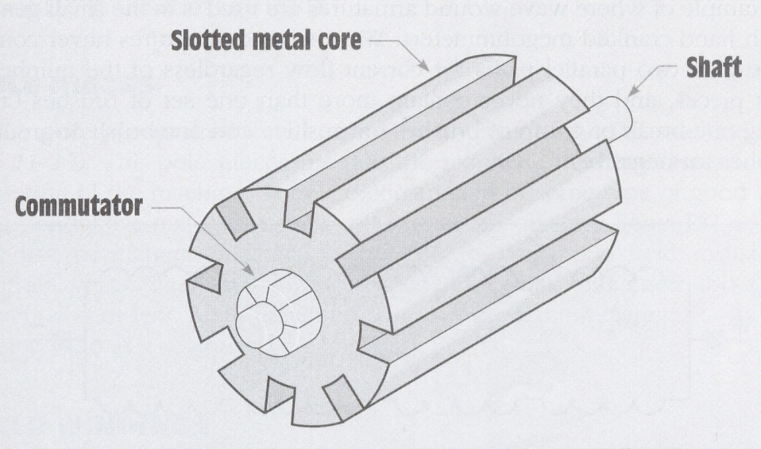
Slots
They are punched uniformly round the gap surface of the armature (i.e. that fixed or rotating member of the machine that carries the armature winding).
Coils are placed in the slots.
The slots may be open, semi-closed or closed.
Slots provide mechanical support for the conductors.

Slide 6
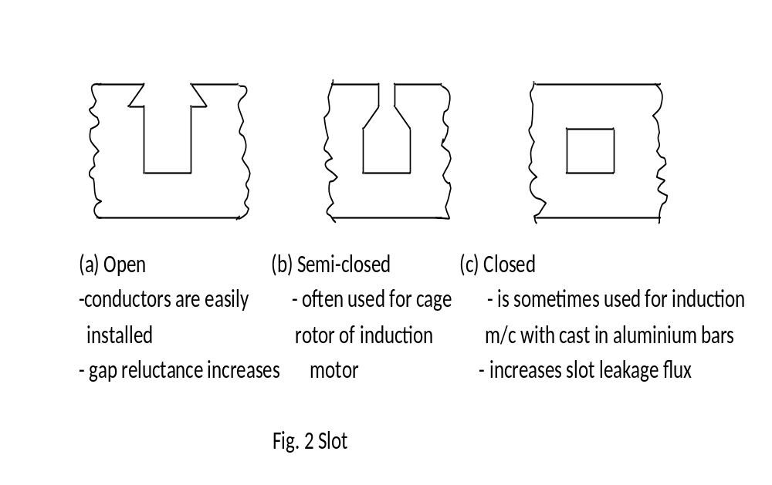
Slots

Slide 7

Single-layer and two-(or double-)layer windings
The way slots are filled with the sides of coils gives two basic types of armature windings:
Single-layer winding:
In this winding each side of one coil occupies a whole slot.
The coils contain many insulated turns.
Single-layer coils have the advantage that semi-closed or closed slots can be easily used.

Slide 8
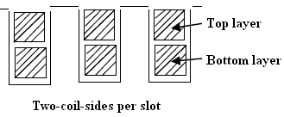
Single-layer and two-(or double-)layer windings
Two-layer winding
  Here one side of a coil lies in the top half of a slot and the other side in the bottom half of another slot a pole-pitch or less away.
  All coils are identical.
  Open slots are frequently used.

Slide 9
Lap and wave winding
The front-end of a two-layer coil can be bent inward or outward to bring about the connection from one coil to another.
Inward gives what is called a lap winding and
Outward gives what is called a wave winding

Slide 10
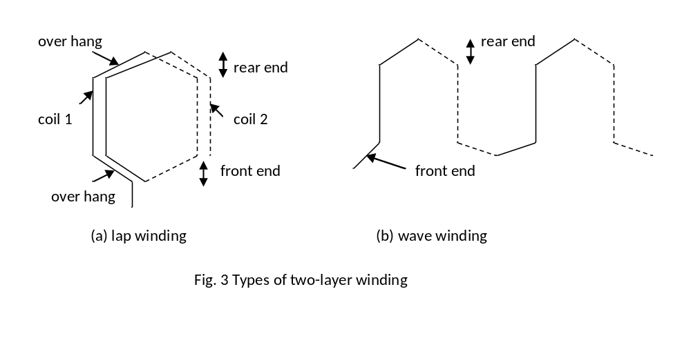
Lap and wave winding

Slide 11
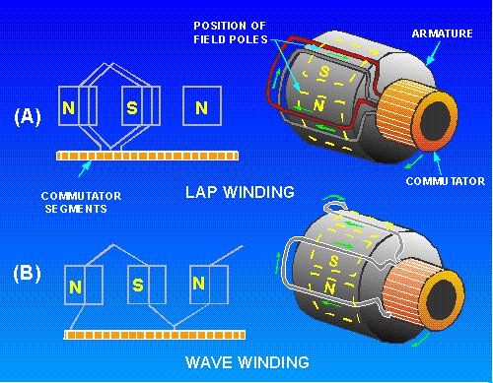

Slide 12
Common winding terms and symbols
  Conductor: the active length of wire or strip (bar) in the slot. Z = total number of conductors in a winding.
  Coil: single-turn coil consists of two conductors separated by a pole-pitch or nearly so connected back to back. In multi-turn coil, many conductors occupying virtually the same magnetic position are included before the ends of the coils are brought out. C = total number of coils.
  Coil side: one half of a coil lying in one slot.
  Pole-pitch: the distance between the centres of adjacent poles. It is 180 electrical degrees. The symbol is τ.

Slide 13
Common winding terms and symbols
  Back pitch or coil pitch (or coil span):
  it is the span of a coil. It is measured in coil sides, sometimes as a fraction of the full pole-pitch or in electrical degrees.
  The symbol is y_{b}. If y_{b} = 180 degrees the coil is called “full-pitch” coil. If y_{b} is less than 180 degrees, the coil is called “fractional pitch” coil or a “chorded” coil.
  Fractional-pitch coils use slightly less copper than full-pitch coils, and they also improve commutation.

Slide 14
Commutator windings
The commutator:
  It consists of many copper segments insulated from and running parallel to one another (mica is used).
  They are clamped around the surface of an insulated cylinder.
  To each commutator bar or segment is connected a coil junction (i.e. where a coil is joined to another). Hence the number of bars = the number of coils in the winding.
  The commutator enables us to obtain a steady and direct voltage from alternating emf generated in the armature conductor.

Slide 15
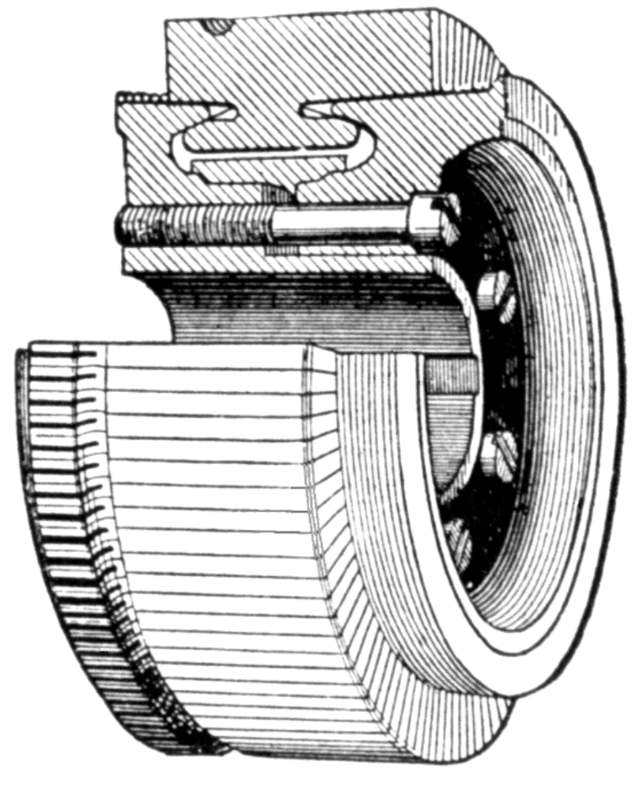
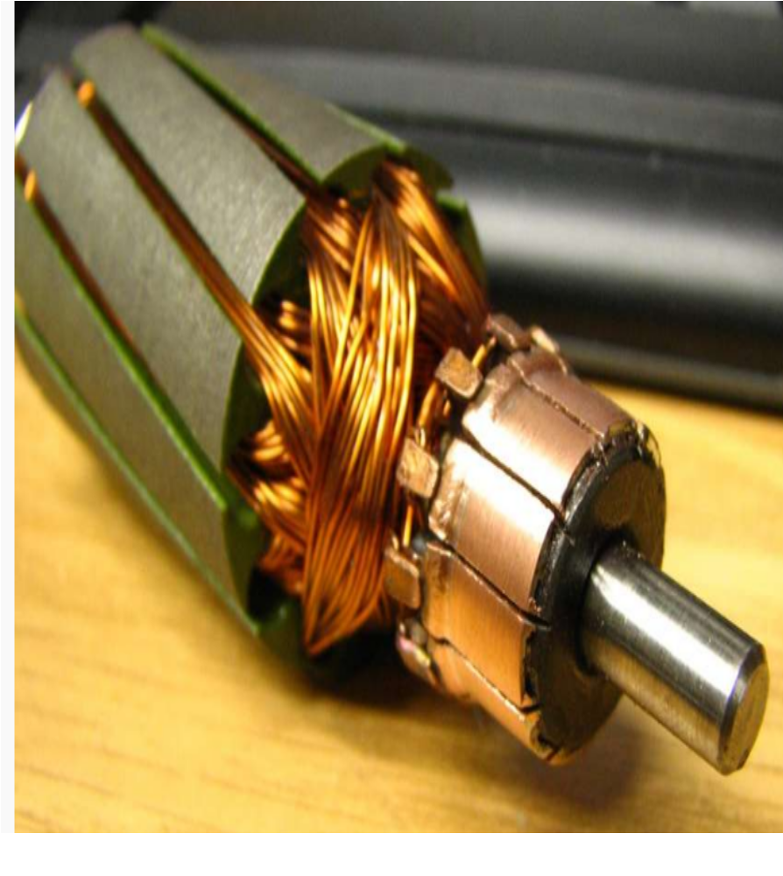

Slide 16
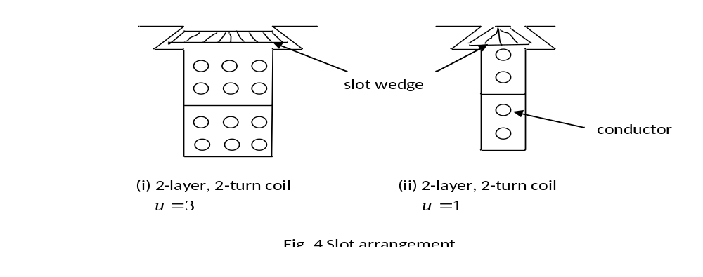
Type of layer or winding: two-layer coils are employed.
Slot arrangement: we note that
  the number of coils per slot = coil sides per layer.
  from the definition, C =Su
  u =1 is rarely used. u = 2, 3, 4 or even more coil sides/layer are used.

Slide 17
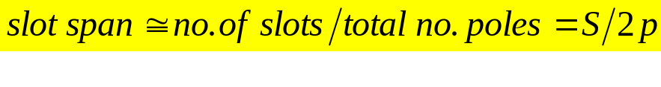
  Other terms used in commutator winding:
Slot span:
It is also used to indicate the span of a coil.
Measured in slots, it is given by the number of slots or teeth embraced by the coils.
If quotient is integer, then choosing this number for a coil span, a normal full-pitch winding is obtained but for special cases, slot span can be taken one slot less to obtain slightly chorded winding. If quotient is not an integer, then the nearest integer lower than S/2p is taken.
In actual machine slot span lies between 10 and 15 and it is slightly less than S/2p.

Slide 18
Coil-end pitch or commutator pitch
it is the distance between the end connections of a coil.
It is measured in commutator segments or bars between the two legs of the coil.
Progressive or retrogressive winding:
In progressive winding, winding progresses in the direction in which the coils are wound
whereas in retrogressive winding, winding progresses in the opposite direction.

Slide 19
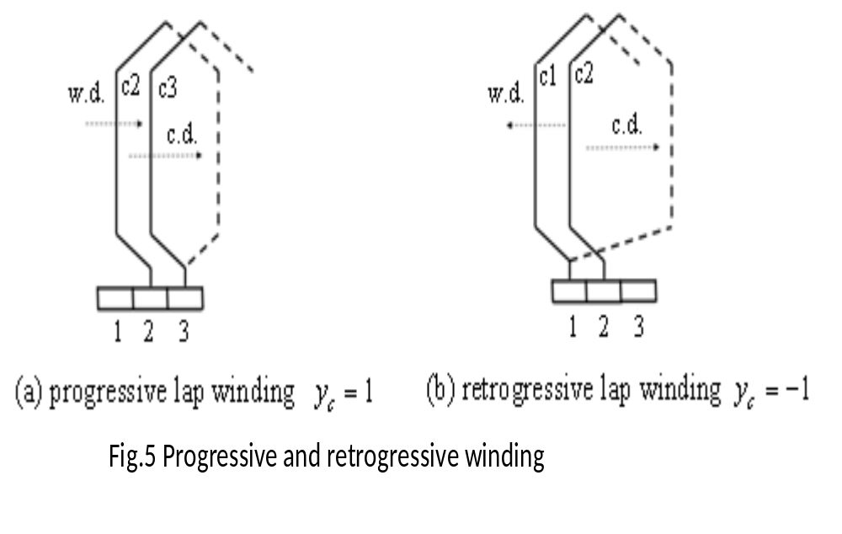

Slide 20
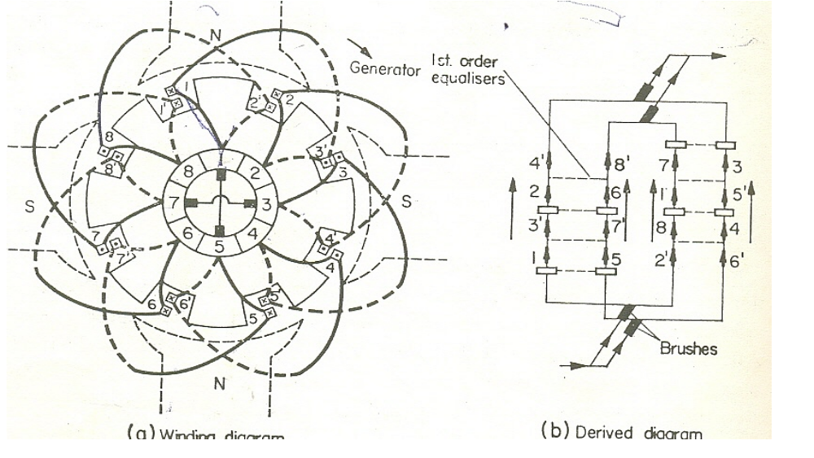
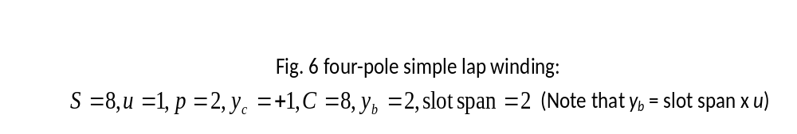
Simple lap winding

Slide 21
    Determining type of machine when direction of rotation is given:
      In generators, torque is in direction opposite to that of the speed, whereas in motors, torque and speed are in the same direction.
      Therefore, when we know the direction of the speed and the direction of the torque, we can determine the type of machine.
      The direction of the torque is determined as shown in Fig. 7

Slide 22
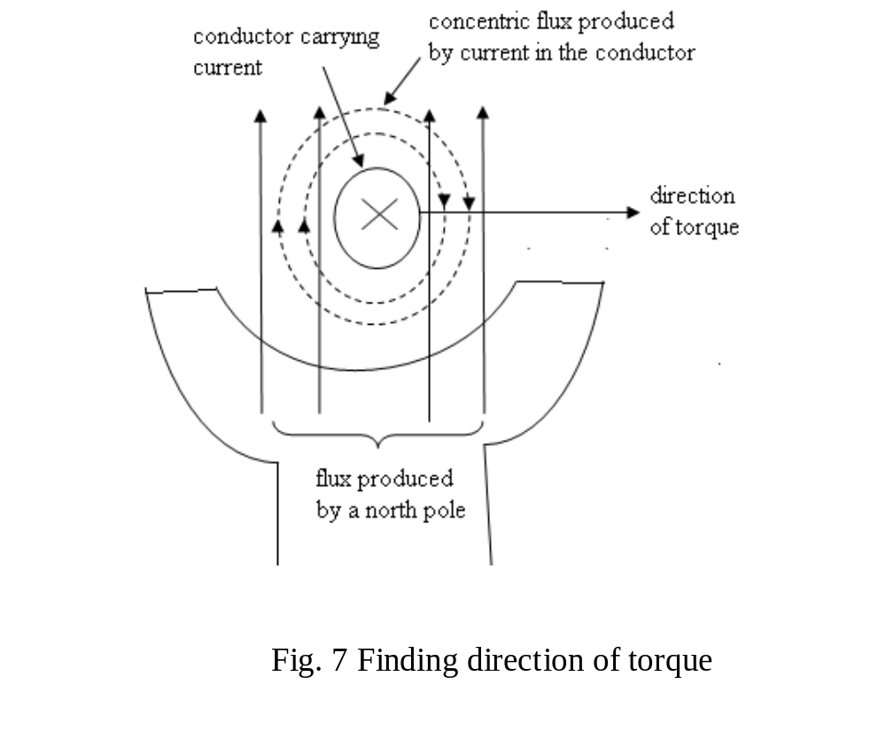

Slide 23
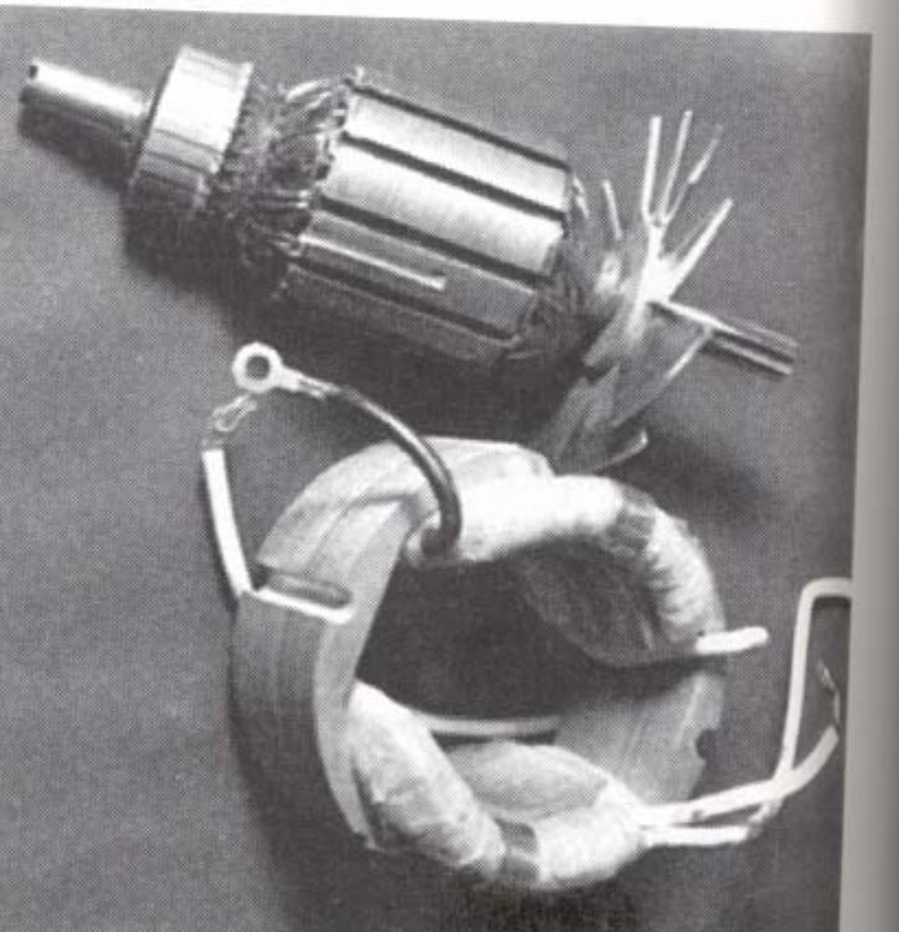
Exercise 1
The machine in Fig. 6 is operating as a generator with the armature rotating in the clockwise direction. Determine the direction of the current in conductors 1 and 1’
Ratio of pole arc to pole-pitch
In practical machines, this varies
from 0.67 to 0.75
Brushes
no. of brushes = no. of poles
they are equally spaced
in their normal or neutral position, they short coils which have their sides moving through low-flux inter-polar zone.

Slide 24
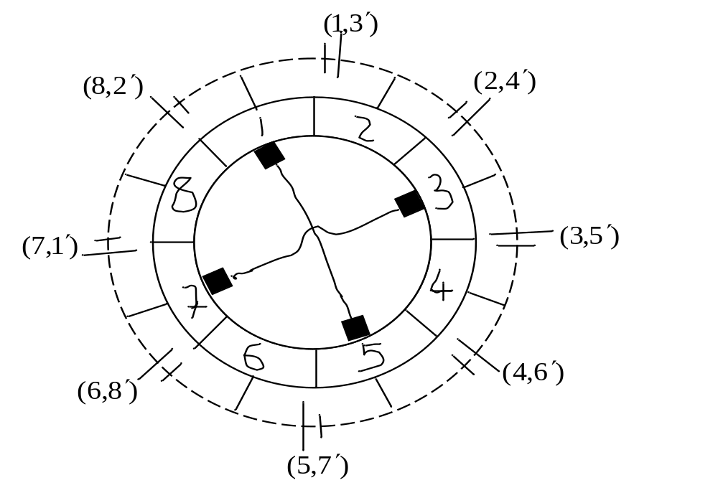
Parallel paths:
number of parallel paths = number of poles
a parallel path consists of all top-layer conductors under one pole, together with all the bottom-layer conductors under one neighbouring pole. See Fig. 8.
  Fig. 8 Diagram showing parallel paths of machine in Fig. 6

Slide 25
Total emf
The total resulting emf induced between brushes is not completely constant. Variations arise as rotor changes position.
This can be seen from Fig. 6 with the rotor displaced through one-half the commutator segment. The displacement will result in four coils being short-circuited.
In practical machine the variations are very small. Hence the number of conductors in series per circuit or parallel path is given by Z/2p

Slide 26
Equalizers:
Some dc lap winding machines have equalizers.
The emfs in the parallel paths are supposed to be the same but they are not because practical machines are not perfectly symmetrical.
The equalizers are used so that circulating currents caused by slight discrepancies in the generated emfs in the parallel paths will flow through them rather than through the brushes
An equalizer connects together all noses of coils or commutator segments which should be at the same potential or which are exactly similarly situated with respect to the magnetic system

Slide 27
Equalizers Cont’d:
The number of top layer coil sides which can occupy identical positions relative to the magnetic system = p.
If the necessary condition is fulfilled for the p coil sides to occupy identical positions then the coils in the winding can be divided into C/p groups, each group consisting of p coils occupying the same identical positions.
For top layer coil sides to occupy identical positions relative to the magnetic system, the ratio S/p must be an integer.
This condition must be fulfilled if equalizers are to be used.
In the design of lap windings, it is required that S/p be an integer. We note that when S/p is an integer then C/p = (S/p)u is also an integer.

Slide 28

Equalizers Cont’d:
Number of coils connected to equalizer or equalizing ring = number of coils occupying identical positions = p.
Not every coil or commutator segment is equalized with that of correspondingly situated coils.
If all coils are to be equalized then C/p equalizers will be required. It generally suffices to use 10 to 20 equalizers.
Equalizers are arranged so that tappings to the various equalizers, which may be connected to commutator segments or noses of the coils, shall be equally spaced.

Slide 29
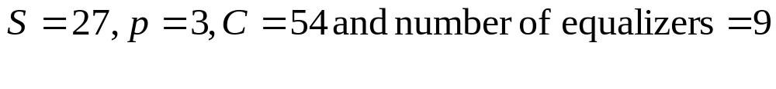
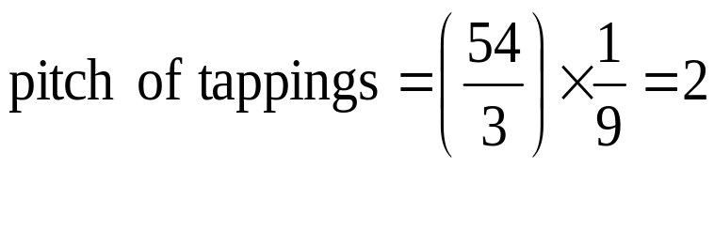
Equalizers Cont’d:
The pitch must be an integer.
With the maximum number of equalizers C/p pitch of tapping points = 1
For example, if
then
The equalizers will be connected to the commutator segments as shown in Table 1.

Slide 30
